Slide 1
Movie Now
UR Xtech
Julio A. Silva, Kaden Goski, Paul Wangwe
December 2nd, 2019

Slide 2
Our project vision
What is your team’s Golden Circle
Why – To make it simpler and easier to review/find new movies.
How – With our development team and resources from the U of R
What – A website to review movies
Review the “deep dive”
What exactly are you doing?
A user friendly website that allows users to look for reviews as well as write them and even vote for the best one in order to filter them.
What gap are you trying to fill?
There are a lot of movie review websites out there, the main difference with ours is that we are only showing relevant information.
Discuss from your team’s
Project vision: A website
Rationale: Current movie review options shows irrelevant information with their designs,
Stakeholders: Users who just want to see reviews when they are looking for a movie to watch
Assumptions: Out website has the latest movies in its database where you can visualize reviews.
Constraints: Time

Slide 3
Team work/responsibilities
Discuss team member responsibilities throughout the project
All of our team members work basically on everything
We divide the work in two processes:
Developing
Documentation
On milestone 1 and 2 Kaden and Julio focused on the prototypes and the design whereas Paul worked on documentation
On milestones 3 and 4 Kaden did most of the code. Julio and Paul would rotate between documentation and coding.

Slide 4
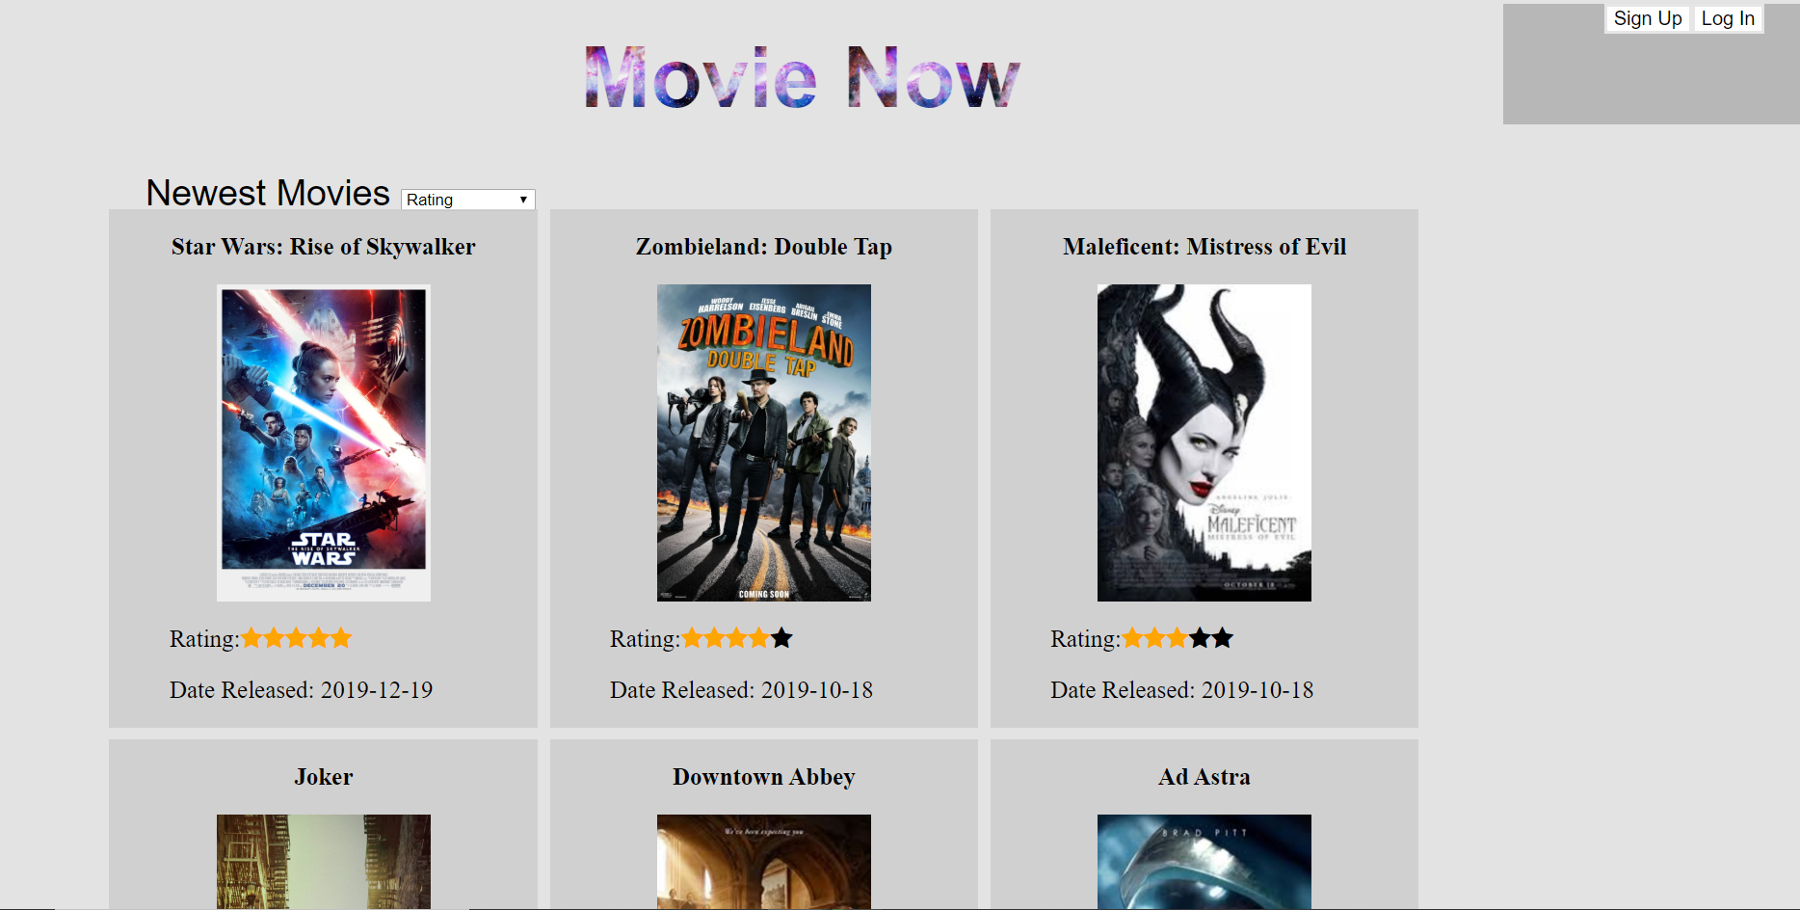
MVP 2 demo
Describe why you feel it is a good MVP
What are things you really like?
Our greatest feature is its functionality, users can sign up, log in, write reviews and rate them.
What are things you think might need some tinkering?
Definitely design
MVP 1 and MVP 2
In MVP 1 only the login and sign up functionalities were working
In MVP 2 users are able to write reviews and rate them.

Slide 5
MVP 2 demo

Slide 6
Feelings, future MVPs & GitHub
Feelings
Do you consider your project a success
Highlights:
Its simple design
Its functionality
Easily scalable
What are some “better-ifs”
If we had more time we could have made a better design.
How many changes/direction shifts did your team take?
At first we were working on an android application but switched to a website system
We also changed our database from WebSQL to MySQL
Do you consider your code clean? Why/why not? Recommendations?

Slide 7
Feelings, future MVPs & GitHub
Discuss what your team envisioned for potential next MVPs
Change Design
Let users edit their profile information
Implement a type of chat so users can talk between them.
Review your team’s GitHub
Github link: https://github.com/alpacamusical/Project-ENSE-374

Slide 8
Group reflection
How did you feel about this project? What did you like about it? What did you dislike?
We learn our weaknesses and strengths, at first it was kind of hard to decide which tools to use or on what should everyone work but sort it out.
What did you learn about yourself as you collaborated and worked through this project?
That we can get better results as teams rather than individuals.
How will you use what you have learned going forward?
On future projects we will make things right, instead of jumping right into coding we will analyze requirements and design so we avoid errors.
What “stuff & things” related to this project would you want help with? – Could have been better?
Database and javascript.

